Slide 1
Linear Programming and Simplex Method

Slide 2
Introduction
Search for optimality
- Feasibility vs Optimality
Data collection is important
- Input to the math model
Formulating a Mathematical Model
Decision variables
Objective function (Max/Min) - Measure of performance
Constraints
Parameters Sensitivity Analysis (rough estimate of parameters)

Slide 3
Model validation (Retrospective test, small instances)
Model enrichment (Precision/tractability)
Modeling is more important than solution algorithm
Optimizing vs Satisfying
(Satisfactory & Optimizing)
Exact methods Heuristics or Metaheuristics
Sensitivity analysis / Post optimality analysis
Complexity classes: P, NP, NP-complete, NP-hard

Slide 4
Example
Plant | Production times per batch (hrs) |  | Production time available per week (hrs)
 | Product 1 (Rosgulla) | Product 2 (Son Papdi)
1 (chana) | 1 | 0 | 4
2 (Besan) | 0 | 2 | 12
3 (Sugar & assembly | 3 | 2 | 18
Profit per batch | $ 3000 | $5000

Slide 5

x₁ = number of batches of product 1 per week
x₂ = number of batches of product 2 per week
Z = 3 x₁ + 5 x₂
Max Z = 3 x₁ + 5 x₂ Plant 1: Aluminium frame and hardware
Subject to: Plant 2: Wood frame
x₁ $≤$ 4 Plant 3: Glass and assemble
2x₂ $≤$ 12
3 x₁ + 2 x₂ $≤$ 18
x₁ $≥$ 0 ; x₂ $≥$ 0

Slide 6
Graphical Solution
x₂
Z = 36 x₁ = 4
9
Z = 20 slope
6 (2,6) 2x₂ = 12
Z = 10
2
3x₁ + 2x₂ = 18
2 4
Z = 3x₁ + 5x₂
x₂ = - 3/5x₁+ 1/5 Z
Feasible region

Slide 7


Standard form
Max Z = c₁x₁ +……..+ c_{n}x_{n}
Subject to:
a₁₁x₁₁ + a₁₂x₁₂ +…………+ a_{1n}x_{1n} $≤$ b₁
…….. …….. ………………. ………. .. …
a_{m1}x_{m1} + a_{m2}x_{m2} +…………+ a_{mn}x_{mn} $≤$ b_{m}
x₁, x₂, x₃,……,x_{n} $≥$ 0
Other forms
$≥ Constraint$
= Constraint
Non-negativity constraint
Ax $≤b$
x $≥0$
Why is it called standard form ?
- limited resources among competing entities

Slide 8

Terminology
Solution
- feasible, infeasible, optimal
3 x₁ + 5 x₂ $≥50$
Feasible region
Objective value
Multiple optimal solution
Unbounded (no optimal solution)
Corner point feasible (CPF)

Slide 9
Modeling
Example 1: LP in transportation
Cost of transport per unit
From \ To | D | E | F | G | Supply
A | 7 | 10 | 14 | 8 | 30
B | 7 | 11 | 12 | 6 | 40
C | 5 | 8 | 15 | 9 | 30
Demand | 20 | 20 | 25 | 35 | 100
7x₁₁ + 10x₁₂ + 14x₁₃ + 8x₁₄ + 7x₂₁ + 11x₂₂ + 12x₂₃ + 6x₂₄ + 5x₃₁ + 8x₃₂ + 15x₃₃ + 9x₃₄

Slide 10

S.t
x₁₁ + x₁₂ + x₁₃ + x₁₄ = 30
x₂₁ + x₂₂ + x₂₃ + x₂₄ = 40
x₁₁ + x₁₂ + x₁₃ + x₁₄ = 30
x₁₁ + x₂₁ + x₃₁ = 20
x₁₂ + x₂₂ + x₃₂ = 20
x₁₃ + x₂₃ + x₃₃ = 25
x₁₄ + x₂₄ + x₃₄ = 35
x₁₁ , x₁₂ …………., x₃₄ $≥0$
Number of linearly independent constraints
(m-1)
What about asymmetric case ?
(m-1) or m ?
Generate this constraint from the rest
Hint: Add first ******

Slide 11
Example 2: Bank loan problem
Funds = $12 million
At least 40% of funds to be allocated to farm and commercial loans.**********************************atleast 50% of personal, car and Home loans. Overall ratio of bad debts on all loans not to exceed 4%.
Loan Type | Interest rate | Bad debt rate
(x₁) Personal | 0.140 | 0.10
(x₂) Car | 0.130 | 0.07
(x₃) Home | 0.120 | 0.03
(x₄) Farm | 0.125 | 0.05
(x₅) Commercial | 0.100 | 0.02

Slide 12

solution
Max. 0.14(0.9x₁) + 0.13(0.93x₂) + 0.12(0.97x₃) + 0.125(0.95x₄) + 0.1(0.98x₅) – 0.1x₁ – 0.07x₂ – 0.03x₃ – 0.05x₄ -0.02x₅
S.t
x₁ + x₂ + x₃ + x₄ + x₅ $≤12$
x₄ + x₅ $≤12∗40\%$
x₃ $≥0.5 ($x₁ + x₂ + x₃)
(0.1x₁ +0.07x₂ + 0.03x₃ + 0.05x₄ + 0.02x₅) / (x₁ + x₂ + x₃ + x₄ + x₅ ) $≤$ 0.04
x₁, x₂, x₃,x₄,x₅ $≥$ 0

Slide 13

Example 3: Product mix Problem
per unit Product
Solution:
Max 100T + 60C
5T + 2C $≤$ 270
4T + 3C $≤$ 250
3T + 4C $≤$ 200
T $≥0 ;C≥$ 0
4T – C = 0
Resource\Item | Table | Chair | Resource available
Machining | 5 | 2 | 270
Sanding | 4 | 3 | 250
Assembly | 3 | 4 | 200
Profit (p) | 100 | 60
Four chairs for each table: C =4T

Slide 14

Example 4: A diet Problem
Foodstuff
Solution: x, y, z
Min 15.60x + 18.90y + 12.70z
s.t
4x + 2y + 4z $≥$ 440
2x + 3y + 3z $≥$ 150
3x + y + 3z $≥$ 320
x, y, z $≥$ 0
Item | A | B | C | Requirements
Machining | 4 | 2 | 4 | 440+
Sanding | 2 | 3 | 1 | 150+
Assembly | 3 | 1 | 3 | 320+
Cost ($/kg) | 15.60 | 18.90 | 12.70

Slide 15

Example 5: A vehicle mix Problem
per unit Product
Solution:
Maximum volume transported = 24x₁ + 16x₂
s.t
24x₁ + 16x₂ $≤$ 4000
3x₁ + 9x₂ $≤$ 720
x₁ + x₂ $≤$ 100
x₁, x₂ $≥0$
 | Table | Chair | Resource available
Fuel (L) | 50 | 25 | 4000
Maintenance (h) | 3 | 9 | 720
Load carried (m³) | 24 | 16 | -
Maximum number of vehicles allowed | - | - | 100

Slide 16
Information value
User’s capabilities
******* to healthy population
Learn parameters
Direct user’s
Robust operation
Estimate the possibilities
Many assumptions

Slide 17
CPF – two constraint boundaries for 2D problem
n constraint boundaries of { x₁,……., x_{n}} problem
Adjacent CPF – If they share an edge (one constraint boundary for 2D problem)
( n-1 constraint boundary for n-D problem)
x₁ = 4
(2,6)
(0,6)
2x₂ = 12
x₂
(4,3)
Max Z = 3x₁ + 5x₂
(0,0)
(4,0)
x₁
3x₁ + 2x₂ = 18
Constraint boundary

Slide 18
Optimality test : If a CPF solution has no adjacent CPF solution that is better, it must be an optimal solution.
Solving the example
Initialization: (0,0)
optimality test : (0,0) is not better than adjacent solution
Iteration 1
Choose moving along x₂ axis. Why ? Z = 3x₁ + 5x₂
rate of increase is faster in x₂ in Z
Stop as it hits the constraint boundary 2x₂ = 12; x₂ = 6
Find the new CPF – (0,6)
(0,6) optimal ? – No
Move towards right – increases x₁ Z
Stop at the constraint boundary 3x₁ + 2x₂ = 12
Find the new CPF (2,6)
Optimality test for (2,6) Optimal. STOP

Slide 19
Key Solution concepts
Concept 1 : Focus solely on CPF solutions reduces computational burden greatly
Concept 2 : Initialization
optimality test
No Yes STOP
Iteration
Concept 3 : Choose the origin, whenever feasible
(what happens when origin is not a feasible solution)
Concept 4 : Look for adjacent CPF than all CPFs
Ensures quick computation
Concept 5 : “Rate of improvement” instead of computing values of adjacent CPF
Concept 6 : Optimality test: positive rate of improvement of Z
negative rate of improvement of Z

Slide 20
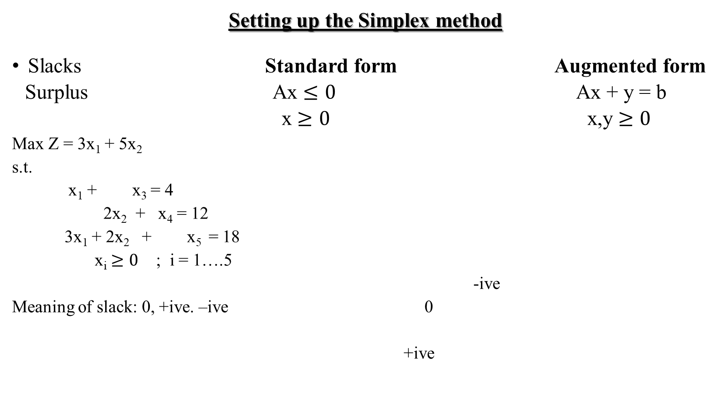
Setting up the Simplex method
Slacks Standard form Augmented form
Surplus Ax $≤0$ Ax + y = b
x $≥0$ x,y $≥0$
Max Z = 3x₁ + 5x₂
s.t.
x₁ + x₃ = 4
2x₂ + x₄ = 12
3x₁ + 2x₂ + x₅ = 18
x_{i} $≥0$ ; i = 1….5
-ive
Meaning of slack: 0, +ive. –ive 0
+ive
For optimal solution (CPF)
Slacks will be zero ?
( for 2D problem)

Slide 21
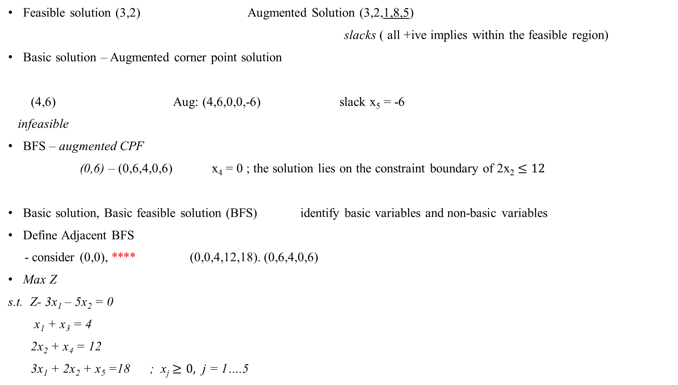
Feasible solution (3,2) Augmented Solution (3,2,1,8,5)
slacks ( all +ive implies within the feasible region)
Basic solution – Augmented corner point solution
(4,6) Aug: (4,6,0,0,-6) slack x₅ = -6
infeasible
BFS – augmented CPF
(0,6) – (0,6,4,0,6) x₄ = 0 ; the solution lies on the constraint boundary of 2x₂ $≤12$
Basic solution, Basic feasible solution (BFS) identify basic variables and non-basic variables
Define Adjacent BFS
- consider (0,0), **** (0,0,4,12,18). (0,6,4,0,6)
Max Z
s.t. Z- 3x₁ – 5x₂ = 0
x₁ + x₃ = 4
2x₂ + x₄ = 12
3x₁ + 2x₂ + x₅ =18 ; x_{j} $≥0,$ j = 1….5

Slide 22
x₁ x₂ x₃ x₄ x₅
(x₁ x₂) (x₁ x₅) (x₃ x₄)
(x₁ x₃) (x₂ x₃) (x₃ x₅)
(x₁ x₄) (x₂ x₄) (x₄ x₅) (x₂ x₅)
Algebra of simplex method
(0,0,4,12,18)
x₁ x₂ (non-basic)
Increase x₂ till x₄ drops to 0 (Hit 2x₂ = 12)
New solution (0,6,4,0,6) Optimal ? No because x₁ can be increased to increase Z.
Increase x₁ till x₅ drops to zero ( Hit 3x₁ + 2x₂ = 18 )
New solution: (2,6,2,0,0) Optimal
8 basic solutions

Slide 23
Initialization
Find initial BFS (0,0,4,12,18)
Proper form of Gaussian Elimination: To convert any BFS to this convenient form
Optimality Test
Z = 3x₁ + 5x₂
Z - 3x₁ - 5x₂ = 0 Coefficients of basic variables are all 0
Coefficients of non-basic variables x₁, x₂ are positive
So, Z is not optimal
Determining the direction of movement
Z - 3x₁ - 5x₂ = 0
choose x₂ as entering basic variable
why Z needs to be expressed as a combination of non-basic variables only ?
- because increasing a NB variable with coefficient 0 might have a positive effect on the basic variables

Slide 24

Determining where to stop
Increase x₂
How the linear system of equations is affected by x₂ ?
x₁ = 0
x₁ + x₃ = 4 x₃ = 4
2x₂ + x₄ = 12 x₄ = 12 – 2x₂
3x₁ + 2x₂ + x₅ = 18 x₅ = 18 – 2x₂
Increase x₂ as long as all these variables remains non-negative
12 – 2x₂ $≥0$ x₂ $≤6$ (minimum)
18 – 2x₂ $≥$ 0 x₂ $≤9$
If x₂ = 6 , x₄ = 0
(leaving basic variable)
Process : Dividing the RHS with the coefficients of entering basic variable and choose the minimum
Minimum Ratio test
- Which basic variable drops to 0 first when we increase x

Slide 25
Solving for the New BF solution :
Now, x₁ = 0, x₂ = 6, x₄ = 0
New BF : (0,6,?,0,?) Find the values of x₃ and x₅
x₃ = 4, x₅ = 6 Conduct the optimality test
Prepare for next iterative
Need for the proper form of Gaussian Elimination
0
Previous coefficient pattern of x₄ 0
1
0
Produce this pattern for x₂ to automatically solve the system of equations

Slide 26
***** Algebraic operation
Multiply (or divide) an equation by as non-zero constant
Add (or subtract) a multiple of one equation to (or from) another equation
-5 0
0 x₂ 0 x₂
2 1
2 0
x₂ + x₄/2 = 6 (New equation)
Z – 3x₁ + 5x₄/2 = 30 Add 5* New equation;
Z is expressed in terms of non-basic variables only (to enable optimality test)
x₁ + x₃ = 4
x₂ + x₄/2 = 6
3x₁ – x₄ + x₅ =6 (subtract 2*New equation)

Slide 27
Since (x₁,x₄) are non-basic x₁,x₄ = 0
Immediately you obtain x₂ = 6, x₃ = 4, x₅ = 6 and Z = 30
Gaussian Elimination Eliminate each basic variable from all the equations except one (its own). (+1)
Optimality Test for the New BF
Z = 30 + 3x₂ – 5x₂/2
Increase x₁ possible rate of improvement
Entering basic variable
x₃ = 4 – x₁ x₁,x₄ = 0
x₅ = 6- 3x₁ minimum
x₁ = 2

Slide 28

x₅ leaving basic variable
0 0 -3
x₁ 0 x₁ 0 x₁ 1
0 0 0
1 1 3 pivot
Z + 3x₄ + x₅ = 36
x₃ + x₄/3 – x₅/3 = 2
x₂ + x₄/2 = 6
x₁ – x₄/3 + x₅/3 = 2 (New equation)
BFS = (2,6,2,0,0)
Z = - 3x₄ - x₅ + 36
So, the current BFS (2,6,2,0,0) is optimal with Z = 36
CPF = (2,6) ******* x₃ $≥0$ , x₄, x₅ = 0

Slide 29
Simplex method in Tabular form
Mechanical way to do computation in a convenient form
Z – 3x₁ – 5x₂ = 0
x₁ + x₃ = 4
2x₂ + x₄ = 12
3x₁ + 2x₂ + x₅ = 18
pivot element/number
coefficient of
Basic variable | Z | x₁ | x₂ | x₃ | x₄ | x₅ | RHS
Z | 1 | -3 | -5 | 0 | 0 | 0 | 0
x₃ | 0 | 1 | 0 | 1 | 0 | 0 | 4
x₄ | 0 | 0 | 2 | 0 | 1 | 0 | 12
x₅ | 0 | 3 | 2 | 0 | 0 | 1 | 18
Ratio
12/2 = 6
18/2 = 9

Slide 30

Initialization : (0,0,4,12,18)
Optimality test : Stop when all coefficients in row 1 is non negative ( $≥0)$
Choose the entering basic variable (pivot column) with the largest negative coefficient
(automatically non-basic)
Minimum ratio test to identify the leaving basic variable
leaving the basis x₁ – entering basic variable
coefficient of
Basic variable | Z | x₁ | x₂ | x₃ | x₄ | x₅ | RHS
Z | 1 | -3 | 0 | 0 | 5/2 | 0 | 30
x₃ | 0 | 1 | 0 | 1 | 0 | 0 | 4
x₂ | 0 | 0 | 1 | 0 | 1/2 | 0 | 6
x₅ | 0 | 3 | 0 | 0 | -1 | 1 | 6
Ratio
4/1 = 4
6/3 = 2

Slide 31
coefficient of
Basic variable | Z | x₁ | x₂ | x₃ | x₄ | x₅ | RHS
Z | 1 | 0 | 0 | 0 | 3/2 | 1 | 36
x₃ | 0 | 0 | 0 | 1 | 1/3 | -1/3 | 2
x₂ | 0 | 0 | 1 | 0 | 1/2 | 0 | 6
x₁ | 0 | 1 | 0 | 0 | -1/3 | 1/3 | 2

Slide 32
Tie Breaking of Simplex Method
Tie for entering basic variable : break the tie arbitrarily - -3x₁ + 2x2 <= 12
Tie for leaving basic variable:
First, degenerate BF solution x₂ x₆
x₄
(0,6) x₅
x₃
(-4,0) x₁
Second, if one basic variable retains its value zero, the entering basic variable must also be zero. So, Z remains unchanged
Third, perpetual loop. Z may not increase
Solution :
Change the choice of leaving variable It 1: B: x₃, x₄, x₅, x₆ NB: x₁, x₂
It 2 : B: x₂ x₃, x₄, x₅ NB: x₁, x₆

Slide 33

No leaving Basic variable - Unbounded It 3:
Max 3x₁ + 5x₂
s.t. x₁ $≤4$ x₁ + x₃ = 4
x_{1,} x₃ $≥0$
 | Z | x₁ | x₂ | x₃ | RHS
Z | 1 | -3 | -5 | 0 | 0
x₃ | 0 | 1 | 0 | 1 | 4
None

Slide 34
Multiple optimal solution
Z = 3x₁ + 2x₂
Basis | Z | x₁ | x₂ | x₃ | x₄ | x₅ | RHS
Z | 1 | 0 | 0 | 0 | 0 | 1 | 18
x₁ | 0 | 1 | 0 | 0 | -1/3 | 1/3 | 2
x₃ | 0 | 0 | 0 | 1 | 1/3 | -1/3 | 2
x₂ | 0 | 0 | 1 | 0 | ½ | 0 | 6
Basis | Z | x₁ | x₂ | x₃ | x₄ | x₅ | RHS
Z | 1 | 0 | 0 | 0 | 0 | 1 | 18
x₁ | 0 | 1 | 0 | 1 | 0 | 0 | 4
x4 | 0 | 0 | 0 | 3 | 1 | -1 | 6
x₂ | 0 | 0 | 1 | -3/2 | 0 | 1/2 | 3

Slide 35

Adapting to other model forms
Ax = b Ax $≥b$
Ax $≤b$ Increase the number of constraints
Very big number
3x₁ + 2x₂ = 18
Z – 3x₁ – 5x₂ + Mx₅ = 0 ……(0)
x₁ + x₃ = 4 …………………. (1)
2x₂ + x₄ =12 ……………… (2)
3x₁ + 2x₂ + x₅ = 18 ………..(3)
Artificial variable
Z = 30 – 6M (2,6)
(0,6) Z = 36
counter-clockwise movement
(4,3) Z = 27
(0,0) (4,0)
Z = 0 -18M Z = 12-6M
Why x₅ will eventually become 0 ?
Why M will vanish from the objective ?
Because the feasible solution will lie on the line

Slide 36
Z – 3x₁ – 5x₂ + Mx₅ = 0 Not suitable
Z = f (non-basic)
*****
Z – 3(1+M) x₁ – (5 + 2M) x₂ = -18M
Basis | Z | x₁ | x₂ | x₃ | x₄ | x₅ | RHS
Z | 1 | -3M – 3 | -5 – 2M | 0 | 0 | 0 | -18M
x₃ | 0 | 1 | 0 | 1 | 0 | 0 | 4
x₄ | 0 | 0 | 2 | 0 | 1 | 0 | 12
x₅ | 0 | 3 | 2 | 0 | 0 | 1 | 18
Basis | Z | x₁ | x₂ | x₃ | x₄ | x₅ | RHS
Z | 1 | 0 | -5 – 2M | 3M +3 | 0 | 0 | -6M
x₁ | 0 | 1 | 0 | 1 | 0 | 0 | 4
x₄ | 0 | 0 | 2 | 0 | 1 | 0 | 12
x₅ | 0 | 0 | 2 | -3 | 0 | 1 | 6

Slide 37
Basis | Z | x₁ | x₂ | x₃ | x₄ | x₅ | RHS
Z | 1 | 0 | 0 | -9/2 | 0 | M + 5/2 | 27
x₁ | 0 | 1 | 0 | 1 | 0 | 0 | 4
x₄ | 0 | 0 | 0 | 3 | 1 | -1 | 6
x₂ | 0 | 0 | 1 | -3/2 | 0 | 1/2 | 3
Basis | Z | x₁ | x₂ | x₃ | x₄ | x₅ | RHS
Z | 1 | 0 | 0 | 0 | 3/2 | M + 1 | 36
x₁ | 0 | 1 | 0 | 0 | -1/3 | 1/3 | 2
x₃ | 0 | 0 | 0 | 1 | 1/3 | -1/3 | 2
x₂ | 0 | 0 | 1 | 0 | 1/2 | 0 | 6
Z = 36 x₁ = 2, x₂ = 6, x₃ = 2, x₄ = 0, x₅ = 0

Slide 38

Negative RHS :
x₁ – x₂ $≤−1$
- x₁ + x₂ $≥ 1$
Surplus variable
Min Z = 0.4x₁ + 0.5x₂ Min Z = 0.4x₁ + 0.5x₂ + Mx₄ + Mx₆
s.t. 0.3x₁ + 0.1x₂ $≤ 2.7$ 0.3x₁ + 0.1x₂ + x₃ $= 2.7$
0.5x₁ + 0.5x₂ $= 6 \text{0.5}\text{x}\text{1}\text{ + 0.5}\text{x}\text{2} \text{+ }\text{x}\text{4}= 6$
0.6x₁ + 0.4x₂ $≥ 6$ 0.6x₁ + 0.4x₂ – x₅ + x₆$= 6$
x₁,x₂ $≥0$ x_{i} $≥0$ i = 1…….6

Slide 39


0.6x₁ + 0.4x₂ $≥0$
(6,6)
(7.5, 4.5)
Z = 5.25
(8,3)
0.3x₁ + 0.1x₂ $≤2.7$ 0.5x₁ + 0.5x₂ = 6
Z = 0 + 12M
Z = 3.6 + 2.1M (9,0) (10,0) Z = 4.7 + 0.5M
CPF for the real problem
CPF for the artificial problem
0.6x₁ + 0.4x₂ $≥6$
(6,6)
(7.5, 4.5)
Z = 5.25
(8,3)
0.3x₁ + 0.1x₂ $≤2.7$ 0.5x₁ + 0.5x₂ = 6
Z = 0 + 12M
Z = 3.6 + 2.1M (9,0) (10,0) Z = 4.7 + 0.5M
First Phase
Obtains a Basic feasible solution for the real problem (artificial variables are driven to zero)
Second Phase
Starts with the BFS from Phase 1, and finds the optimal solution
When you hit
x₆ = 0 and x4 = 0 at (7.5, 4.5), you obtain CPFs for the original problem

Slide 40
- Z = -0.4x₁ - 0.5x₂ - Mx₄ - Mx₆
Basis | Z | x₁ | x₂ | x₃ | x₄ | x₅ | x₆ | RHS
Z | -1 | -1.1M + 0.4 | -0.9M + 0.5 | 0 | 0 | M | 0 | -12M
x₃ | 0 | 0.3 | 0.1 | 1 | 0 | 0 | 0 | 2.7
x₄ | 0 | 0.5 | 0.5 | 0 | 1 | 0 | 0 | 6
x₆ | 0 | 0.6 | 0.4 | 0 | 0 | -1 | 1 | 6
Basis | Z | x₁ | x₂ | x₃ | x₄ | x₅ | x₆ | RHS
Z | -1 | 0 | -16/30 M + 11/30 | 11/3 M – 4/3 | 0 | M | 0 | -2.1M – 3.6
x₁ | 0 | 1 | 1/3 | 10/3 | 0 | 0 | 0 | 9
x₄ | 0 | 0 | 1/3 | -5/3 | 1 | 0 | 0 | 1.5
x₆ | 0 | 0 | 0.2 | -2 | 0 | -1 | 1 | 0.6

Slide 41
Basis | Z | x₁ | x₂ | x₃ | x₄ | x₅ | x₆ | RHS
Z | -1 | 0 | 0 | -5/3 M + 7/3 | 0 | -5/3 M + 11/6 | 8/3M – 11/6 | -0.5M – 4.7
x₁ | 0 | 1 | 0 | 20/3 | 0 | 5/3 | -5/3 | 8
x₄ | 0 | 0 | 5/3 | 1 | 5/3 | -5/3 | -5/3 | 0.5
x₂ | 0 | 0 | 1 | -10 | 0 | -5 | 5 | 3
Basis | Z | x₁ | x₂ | x₃ | x₄ | x₅ | x₆ | RHS
Z | -1 | 0 | 0 | 0.5 | M – 1.1 | 0 | M | -5.25
x₁ | 0 | 1 | 0 | 5 | -1 | 0 | 0 | 7.5
x₅ | 0 | 0 | 0 | 1 | 0.6 | 1 | -1 | 0.3
x₂ | 0 | 0 | 1 | -5 | 3 | 0 | 0 | 4.5

Slide 42
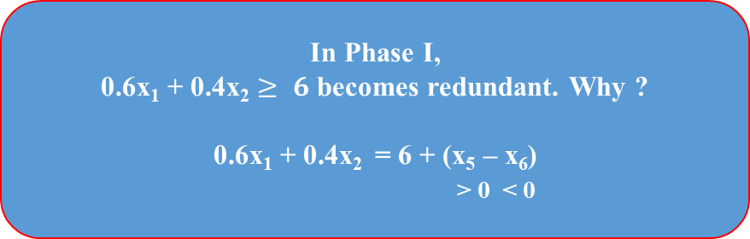

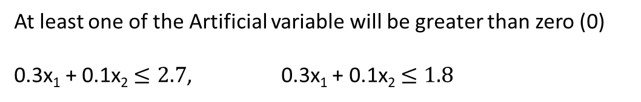
Unboundedness
x₁ $≥2$
x₂
x₂ $≥2$
x₁
Degeneracy
No feasible solution (Infeasibility)
In Phase I,
0.6x₁ + 0.4x₂ $≥ 6$ becomes redundant. Why ?
0.6x₁ + 0.4x₂ = 6 + (x₅ – x₆)
> 0 < 0
At least one of the Artificial variable will be greater than zero (0)
0.3x₁ + 0.1x₂ $≤2.7$, 0.3x₁ + 0.1x₂ $≤1.8$
Multiple optimal solution in Phase I

Slide 43

The Two-Phase method
(without explicitly using M)
Min Z = 0.4x₁ + 0.5x₂ + Mx₄ + Mx₆
Phase 1: Min Z = x₄ + x₆ (until x₄ and x₆ are zero)
Phase 2: Min Z = 0.4x₁ + 0.5x₂ (with x₄ = x₆ = 0)
Min Z = x₄ + x₆ Min Z = 0.4x₁ + 0.5x₂
s.t. 0.3x₁ + 0.1x₂ + x₃ $= 2.7$ s.t 0.3x₁ + 0.1x₂ + x₃ $= 2.7$
$\text{0.5}\text{x}\text{1}\text{ + 0.5}\text{x}\text{2}\text{ + }\text{x}\text{4}= 6$ $\text{0.5}\text{x}\text{1}\text{ + 0.5}\text{x}\text{2} = 6$
0.6x₁ + 0.4x₂ – x₅ + x₆$= 6$ 0.6x₁ + 0.4x₂ – x₅ $= 6$
x_{i} $≥0;$ i = 1….6 x_{i} $≥0;$ i = 1,2,3,5
Phase I
Phase II
Artificial variable driven to 0
BFS
REAL PROBLEM

Slide 44
Basis | Z | x₁ | x₂ | x₃ | x₄ | x₅ | x₆ | RHS
Z | -1 | -1.1 | -0.9 | 0 | 0 | 1 | 0 | -12
x₃ | 0 | 0.3 | 0.1 | 1 | 0 | 0 | 0 | 2.7
x₄ | 0 | 0.5 | 0.5 | 0 | 1 | 0 | 0 | 6
x₆ | 0 | 0.6 | 0.4 | 0 | 0 | -1 | 1 | 6
Basis | Z | x₁ | x₂ | x₃ | x₄ | x₅ | x₆ | RHS
Z | -1 | 0 | -16/30 | 11/3 | 0 | 1 | 0 | -2.1
x₁ | 0 | 1 | 1/3 | 10/3 | 0 | 0 | 0 | 9
x₄ | 0 | 0 | ½ | -5/3 | 1 | 0 | 0 | 1.5
x₆ | 0 | 0 | 0.2 | -2 | 0 | -1 | 1 | 0.6

Slide 45
Tie
Basis | Z | x₁ | x₂ | x₃ | x₄ | x₅ | x₆ | RHS
Z | -1 | 0 | 0 | -5/3 | 0 | -5/3 | 8/3 | -0.5
x₁ | 0 | 1 | 0 | 20/3 | 0 | 5/3 | -5/3 | 8
x₄ | 0 | 0 | 1/3 | 5/3 | 1 | 5/3 | -5/3 | 0.5
x₂ | 0 | 0 | 1 | -10 | 0 | -5 | 5 | 3
Basis | Z | x₁ | x₂ | x₃ | x₄ | x₅ | x₆ | RHS
Z | -1 | 0 | 0 | 0 | 1 | 0 | 1 | 0
x₁ | 0 | 1 | 0 | 0 | -4 | -5 | 5 | 6
x₃ | 0 | 0 | 0 | 1 | 3/5 | 1 | -1 | 0.3
x₂ | 0 | 0 | 1 | 0 | 6 | 5 | -5 | 6

Slide 46
Tie
Basis | Z | x₁ | x₂ | x₃ | x₄ | x₅ | x₆ | RHS
Z | -1 | 0 | 0 | -5/3 | 0 | -5/3 | 8/3 | -0.5
x₁ | 0 | 1 | 0 | 20/3 | 0 | 5/3 | -5/3 | 8
x₄ | 0 | 0 | 1/3 | 5/3 | 1 | 5/3 | -5/3 | 0.5
x₂ | 0 | 0 | 1 | -10 | 0 | -5 | 5 | 3
Basis | Z | x₁ | x₂ | x₃ | x₄ | x₅ | x₆ | RHS
Z | -1 | 0 | 0 | 0 | 1 | 0 (multiple optimal solution) | 1 | 0
x₁ | 0 | 1 | 0 | 0 | -4 | -5 | 5 | 6
x₃ | 0 | 0 | 0 | 1 | 3/5 | 1 | -1 | 0.3
x₂ | 0 | 0 | 1 | 0 | 6 | 5 | -5 | 6

Slide 47
Basis | Z | x₁ | x₂ | x₃ | x₅ | RHS
Z | -1 | 0.4 | 0.5 | 0 | 0 | 0
x₁ | 0 | 1 | 0 | 0 | -5 | 6
x₃ | 0 | 0 | 0 | 1 | 1 | 0.3
x₂ | 0 | 0 | 1 | 0 | 5 | 6
Basis | Z | x₁ | x₂ | x₃ | x₅ | RHS
Z | -1 | 0 | 0 | 0 | -0.5 | -5.4
x₁ | 0 | 1 | 0 | 0 | -5 | 6
x₃ | 0 | 0 | 0 | 1 | 1 | 0.3
x₂ | 0 | 0 | 1 | 0 | 5 | 6
Basis | Z | x₁ | x₂ | x₃ | x₅ | RHS
Z | -1 | 0 | 0 | 0.5 | 0 | -5.25
x₁ | 0 | 1 | 0 | 5 | 0 | 7.5
x₅ | 0 | 0 | 0 | 1 | 1 | 0.3
x₂ | 0 | 0 | 1 | -5 | 0 | 4.5

Slide 48
(6,6)
(7.5,4.5) optimal
(8,3)
Difference with Big-M method
3
4
2
0
1
Why 2-phase method is preferred ?

Slide 49


Revised Simplex method
[A, I] x = b x $≥0$
x_{s} x_{s}
Z = c^{T} x
s.t. Ax $≤$b
x $≥0$
x_{B} = B⁻¹b
Z = c_{B}^{T}x_{B} = c_{B}^{T}B⁻¹b

Slide 50
Example:
c = [3, 5] A,I = 1 0 1 0 0 b = 4
0 2 0 1 0 12
3 2 0 0 1 18
Iteration 0
x_{B} = x₃ B = 1 0 0 = B⁻¹
x₄ 0 1 0
x₅ 0 0 1
x_{B} = B⁻¹b = 4 4
12 Z = [ 0 0 0 ] 12 = 0
18 18

Slide 51
Iteration 1
x_{B} = x₃ B = 1 0 0 B⁻¹ = 1 0 0
x2 0 2 0 0 ½ 0
x₅ 0 2 1 0 -1 1
1 0 0 1 0 0
0 1 0 0 ½ 0
0 0 1 0 -1 1
How ?
B⁻¹

Slide 52
Matrix form of current set of equations
1 -c 0 Z 0
0 A I x = b
xs
Z = 1 c_{B} B⁻¹ 0 = c_{B} B⁻¹ b
x_{B} 0 B⁻¹ b B⁻¹ b
1 c_{B} B⁻¹ 1 -c 0 = 1 c_{B} B⁻¹ A – c c_{B} B⁻¹
0 B⁻¹ 0 A I 0 B⁻¹ A B⁻¹
Pre-multiplying matrix

Slide 53
1 c_{B} B⁻¹ A – c c_{B} B⁻¹ Z c_{B} B⁻¹ b
0 B⁻¹ A B⁻¹ x = B⁻¹ b
coefficients of the slack x_{s}
coefficients of the original variables
Example:
1 1/3 -1/3
Suppose B⁻¹ = 0 ½ 0 c_{B} = [ 0, 5, 3 ]
0 -1/3 1/3
1 1/3 -1/3 1 0 0 0
B⁻¹ A = 0 ½ 0 0 2 = 0 1
0 -1/3 1/3 3 2 1 0

Slide 54
c_{B} B⁻¹ = [ 0, 5, 3 ] = [ 0, 3/2, 1 ]
0 0
c_{B} B⁻¹ A – c = [ 0 5 3 ] 0 1 - [3 5] = [ 0 0 ]
1 0
2
B⁻¹ b = 6 c_{B} B⁻¹ A = 36
2

Slide 55
Full Example:
c = [3, 5] A,I = 1 0 1 0 0 b = 4
0 2 0 1 0 12
3 2 0 0 1 18
Initialization
x₃ 4 c_{B} = [ 0 0 0 ] 1 0 0
x_{B} = x₄ = 12 B = 0 1 0 = B⁻¹
x₅ 18 0 0 1
Optimality Test :
For x₁ , x₂
c_{B} B⁻¹ A – c = [ 0 0 ] - [ 3 5 ] = [ -3 -5 ]
Entering x₂

Slide 56

a₂
0
x₄ $\frac{\text{x}\text{B}}{\text{a}\text{2}}$ min ratio test
leaving 2
1 0 0 1 0 0
B = 0 2 0 B⁻¹ = 0 ½ 0
0 2 1 0 -1 1
x₃ 4
x_{B} = x₂ = B⁻¹b = 6 c_{B} = [ 0 5 0 ]
x₅ 6
2

Slide 57
Optimality test
1 0 0 1 0
For x₁ : c_{B} B⁻¹ A – c = [ 0 5 0 ] 0 ½ 0 0 2 - [ 3 5 ] = [ -3 _ ]
0 -1 1 3 2
Entering x₁
1 0 0
For x₄ : c_{B} B⁻¹ = [ 0 5 0 ] 0 ½ 0 [ __ , 5/2 , __ ]
0 -1 1
a₁
Corresponding column of B⁻¹ A 1 4 4/1
0 x_{B} = 6
x₅ leaving 3 6 6/3 = 2

Slide 58
Original column from [ A, I ]
1 0 1 1 1/3 -1/3
B = 0 2 0 B⁻¹ 0 ½ 0
0 2 3 0 -1/3 1/3
x₃ 2
x_{B} = x₂ = B⁻¹ b = 6 optimal c_{B} = [ 0 5 3 ]
x₁ 2
a₁
1 0 0 1 1 1/3 -1/3
B⁻¹ = 0 ½ 0 0 New B⁻¹ = 0 ½ 0
0 -1 1 pivot 0 -1/3 1/3
a₁
1 0 0 1 0 1 -
B⁻¹ A = 0 ½ 0 0 2 = 0 -
0 -1 1 3 2 3 -
Updating B⁻¹ at every step
3

